Slide 1
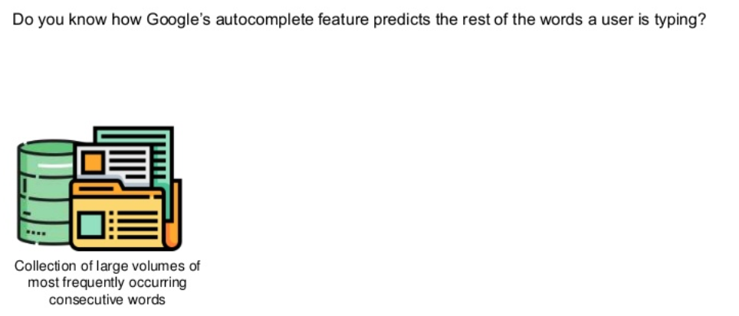
Introduction to RNN

Slide 2
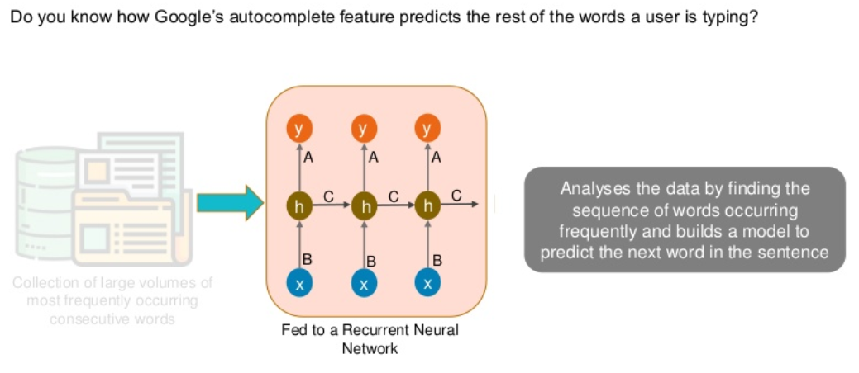
Introduction to RNN

Slide 3
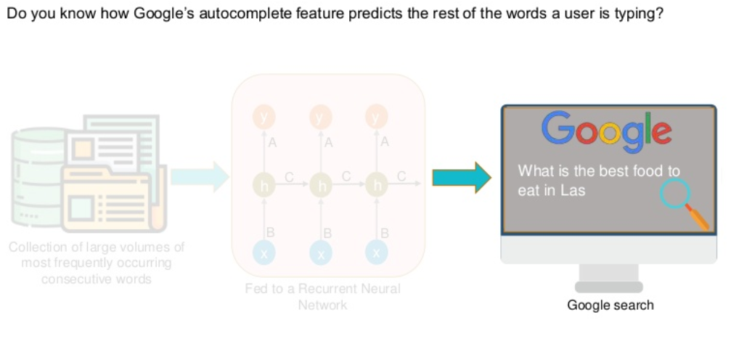
Introduction to RNN

Slide 4
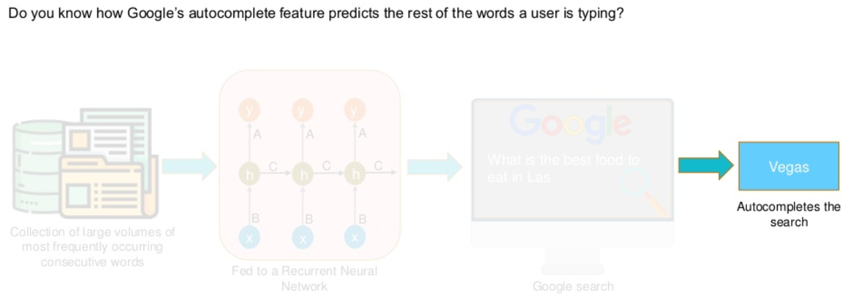
Introduction to RNN

Slide 5
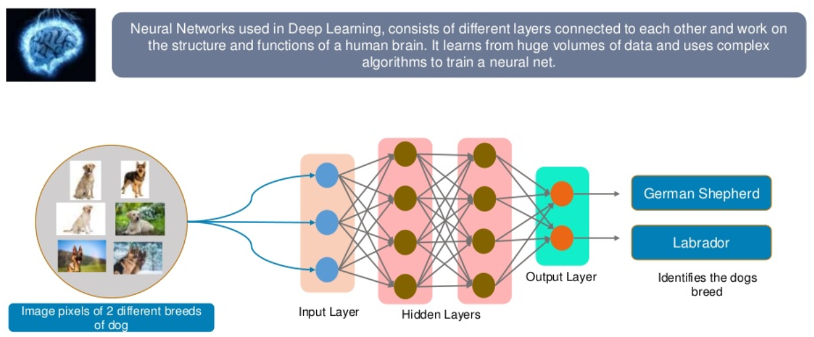
What is a Neural Network

Slide 6
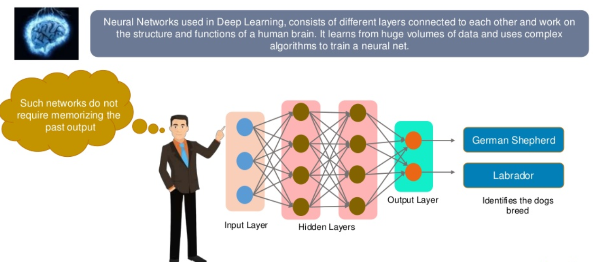
What is a Neural Network

Slide 7
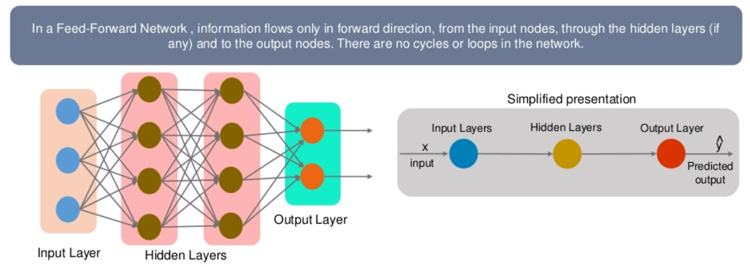
Feed Forward Neural Network
Decisions are based on current input
No Memory about the past
No future scope

Slide 8
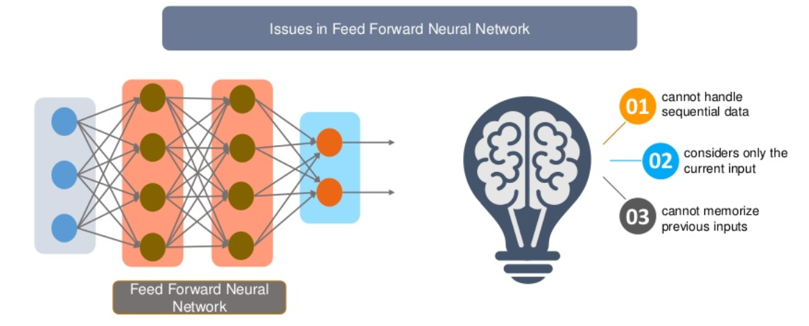
Why Recurrent Neural Network

Slide 9
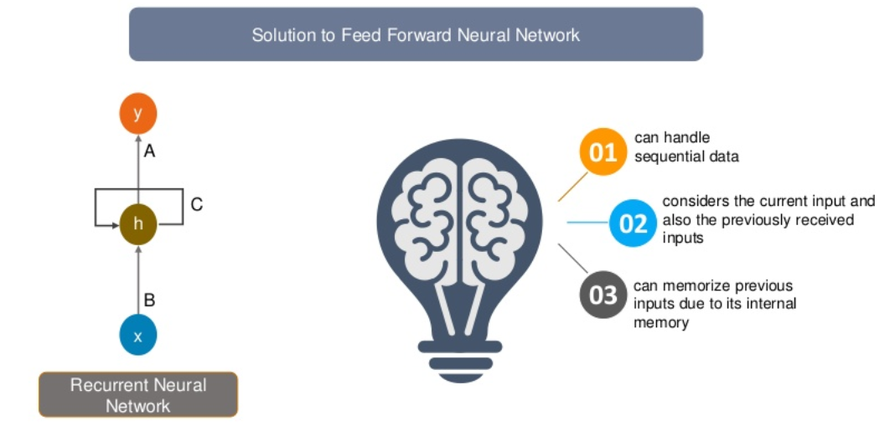
Why Recurrent Neural Network

Slide 10
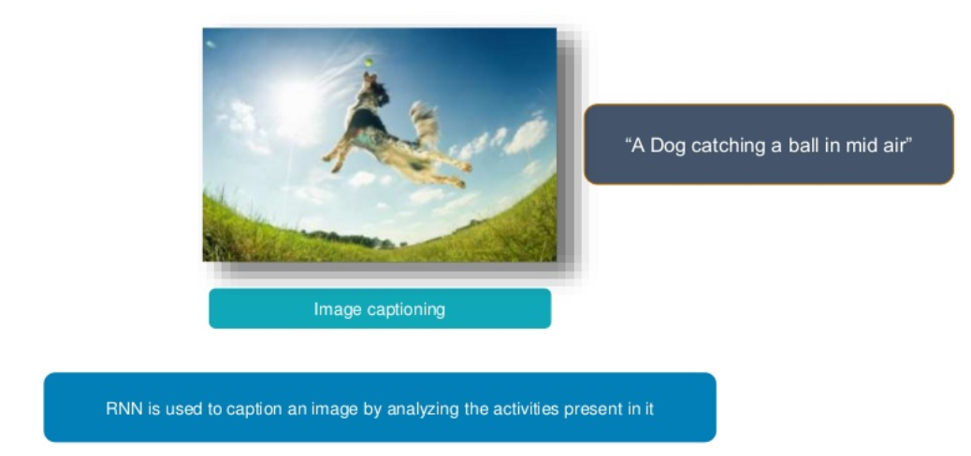
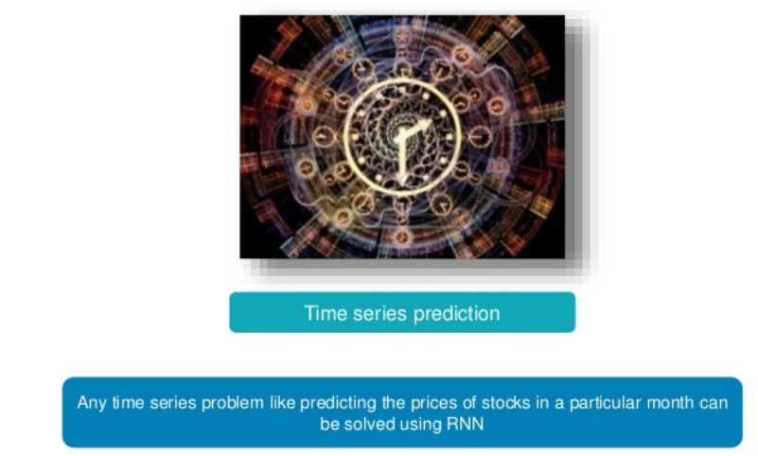
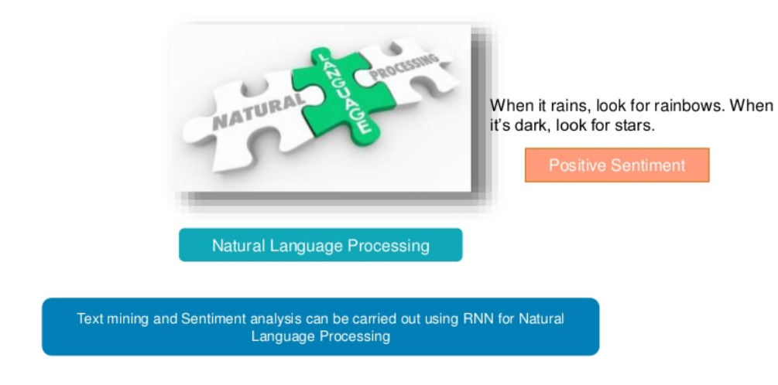

Applications of Recurrent Neural Network

Slide 11
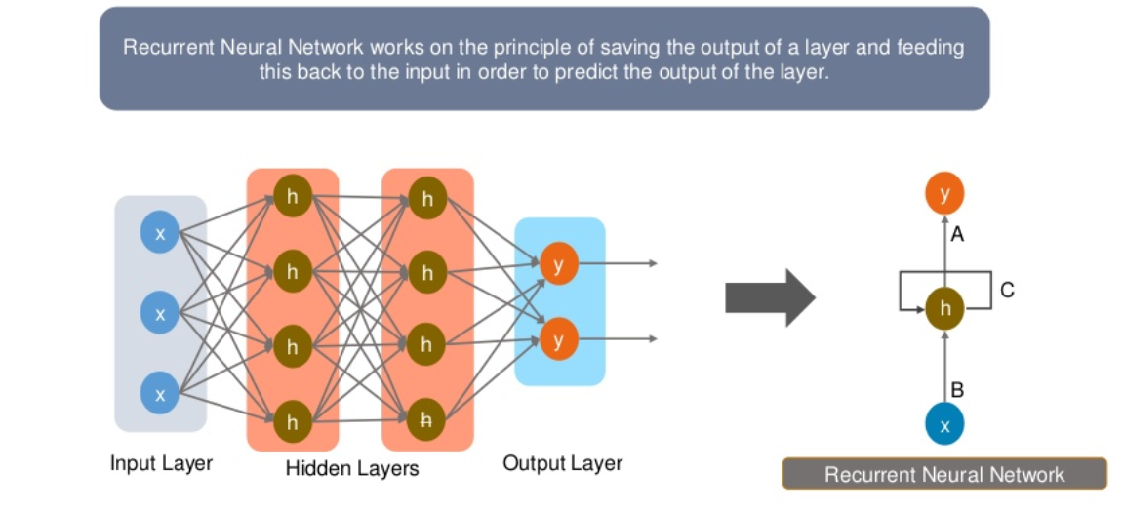
Why Recurrent Neural Network

Slide 12
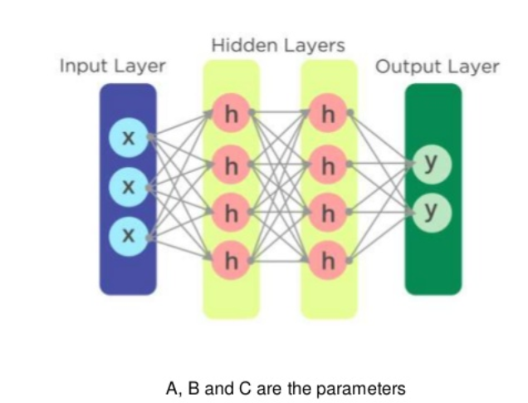
How does RNN look like?

Slide 13
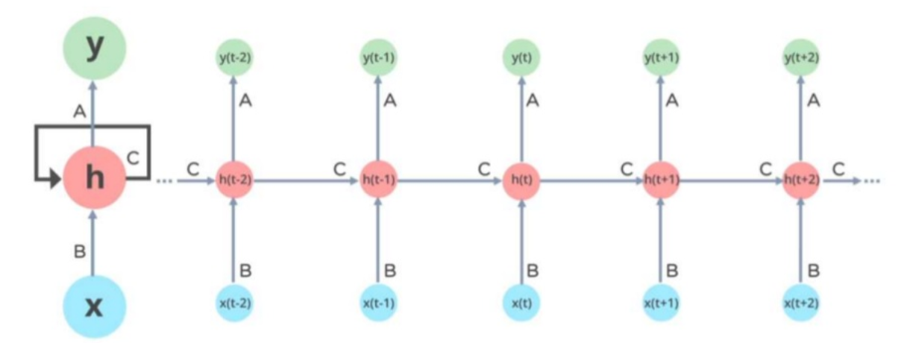
How does RNN look like?

Slide 14
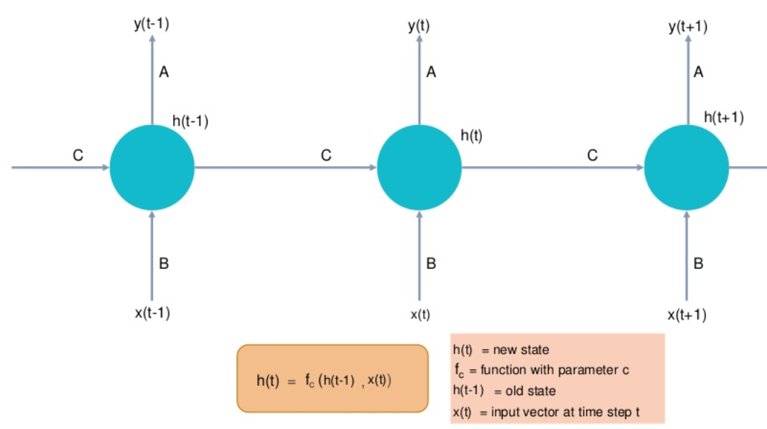
How does RNN work

Slide 15
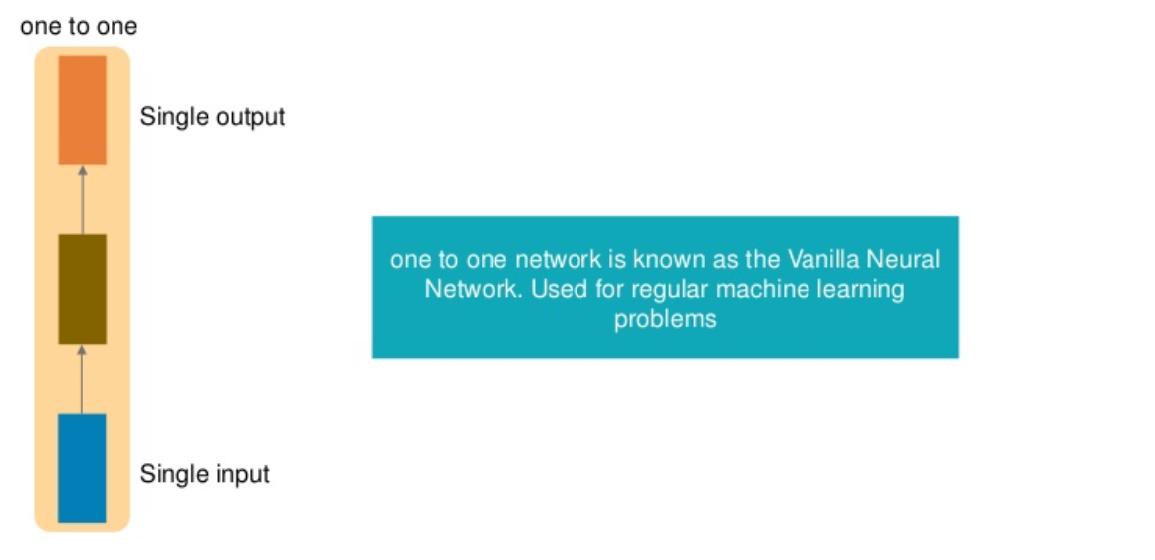
Types of Recurrent Neural Network

Slide 16
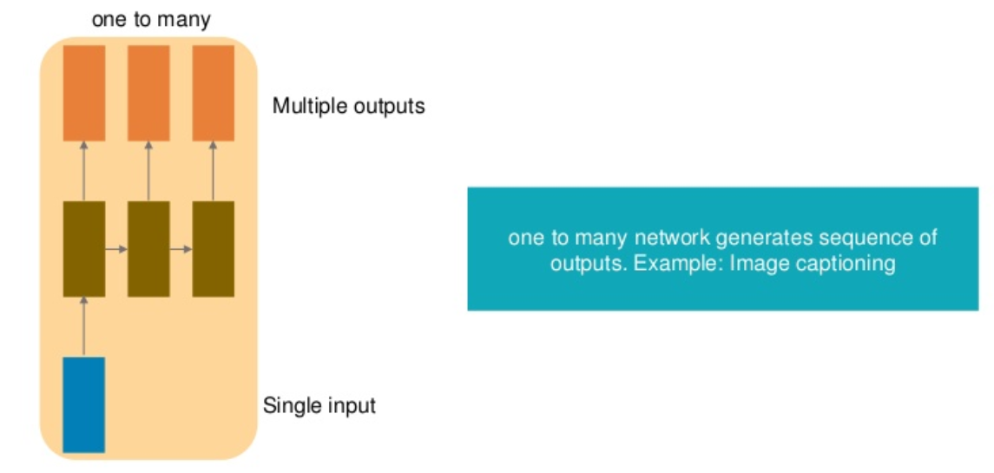
Types of Recurrent Neural Network

Slide 17
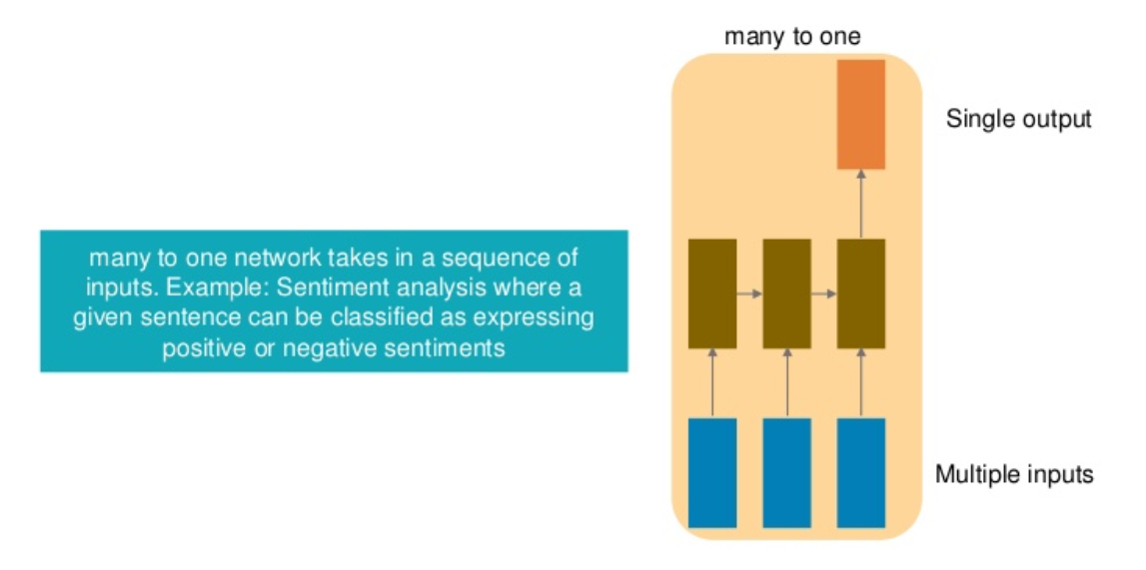
Types of Recurrent Neural Network

Slide 18
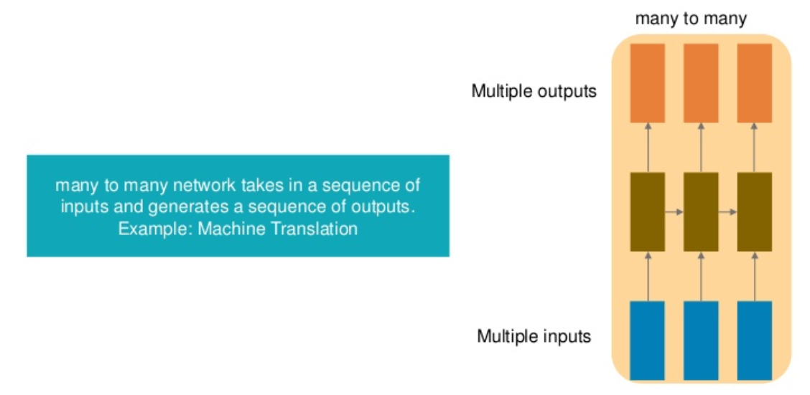
Types of Recurrent Neural Network

Slide 19
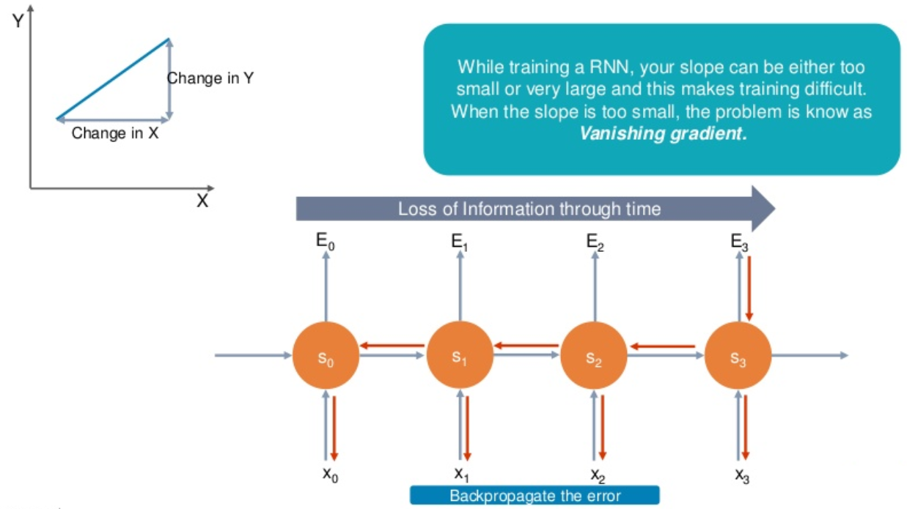
Vanishing gradient problem

Slide 20
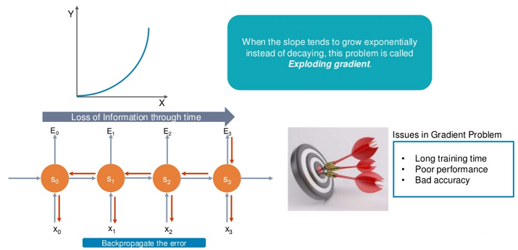
Exploding gradient problem

Slide 21
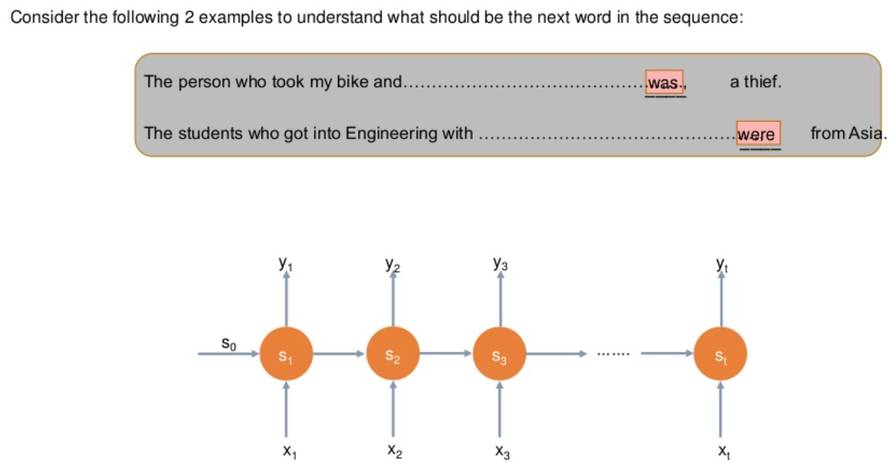
Exploding gradient problem

Slide 22
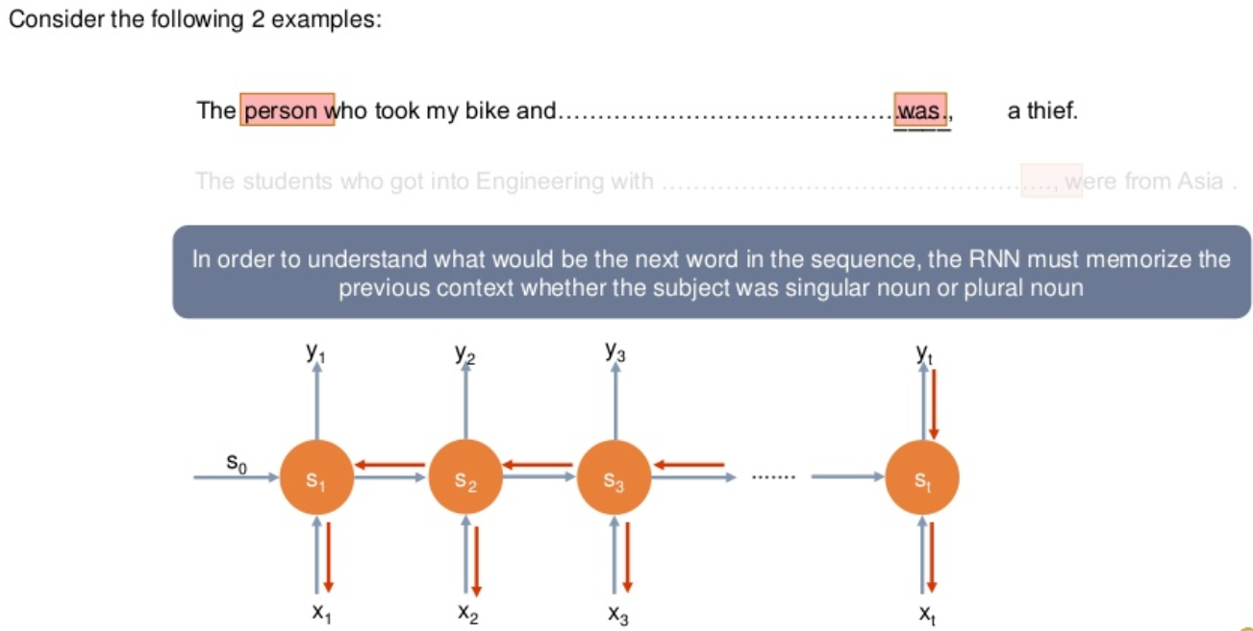
Exploding gradient problem

Slide 23
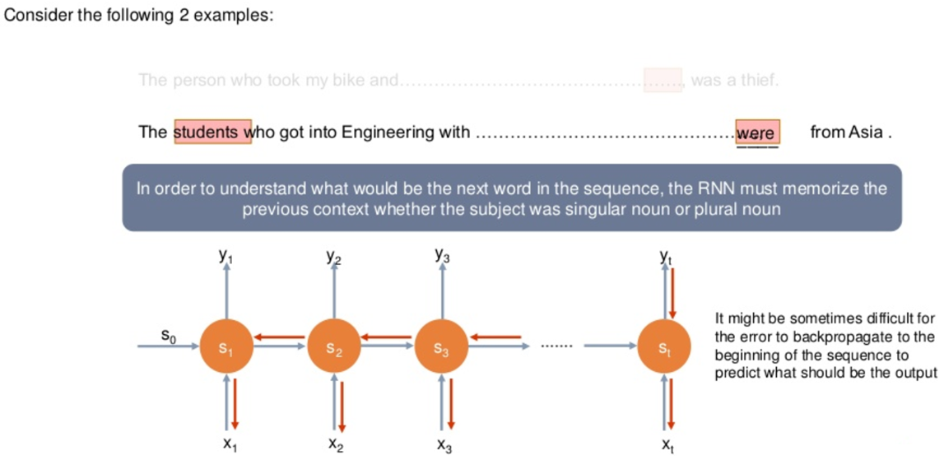
Exploding gradient problem

Slide 24
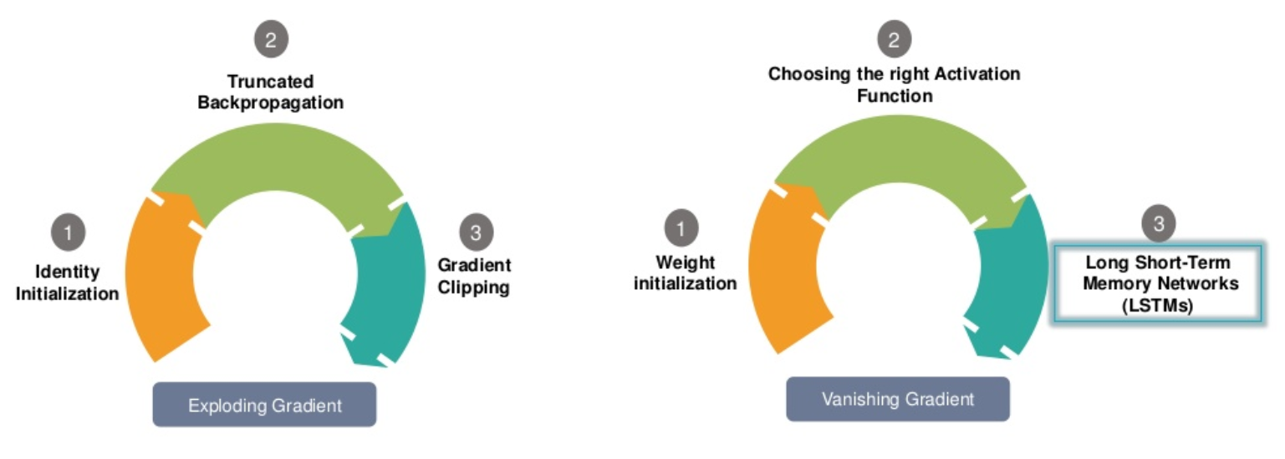
Solution to gradient problem

Slide 25
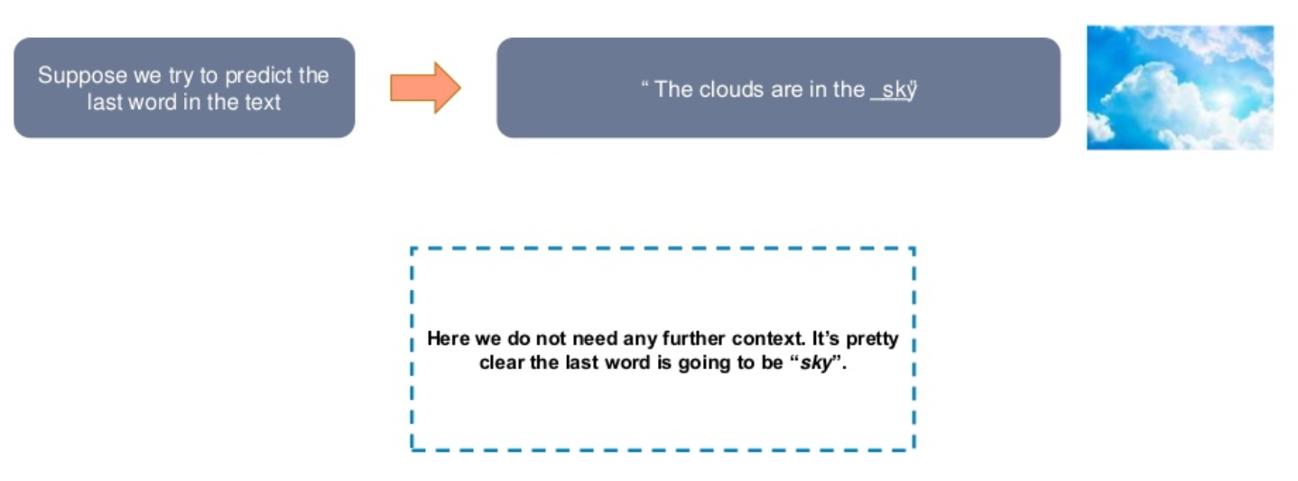
Long term dependencies

Slide 26
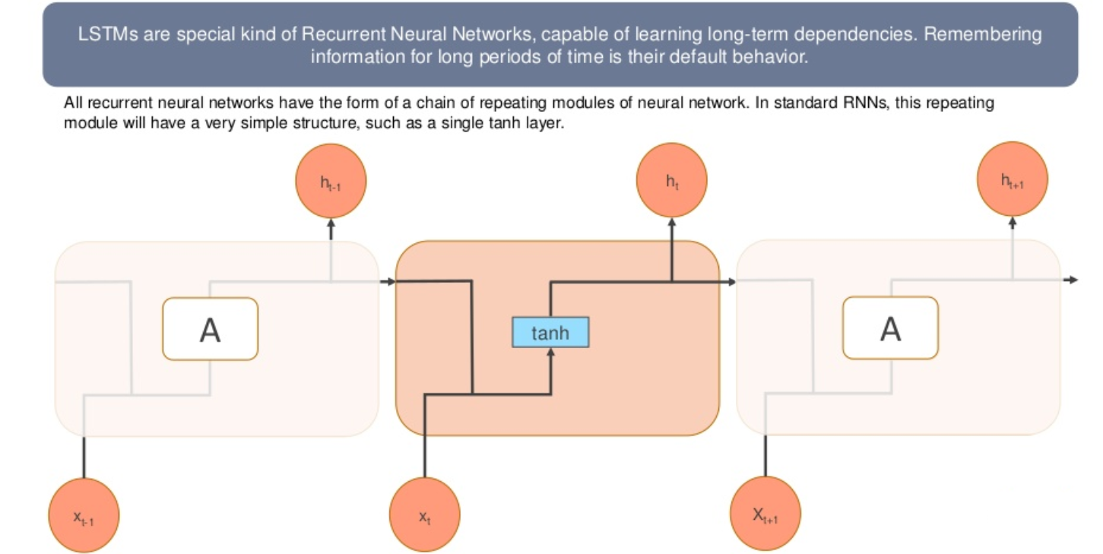
Long short term memory networks

Slide 27
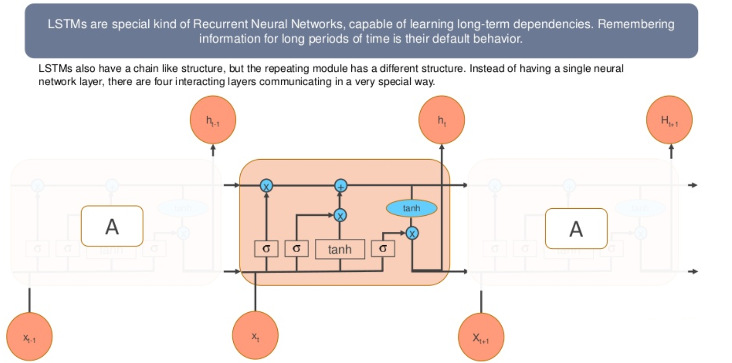
Long short term memory networks

Slide 28
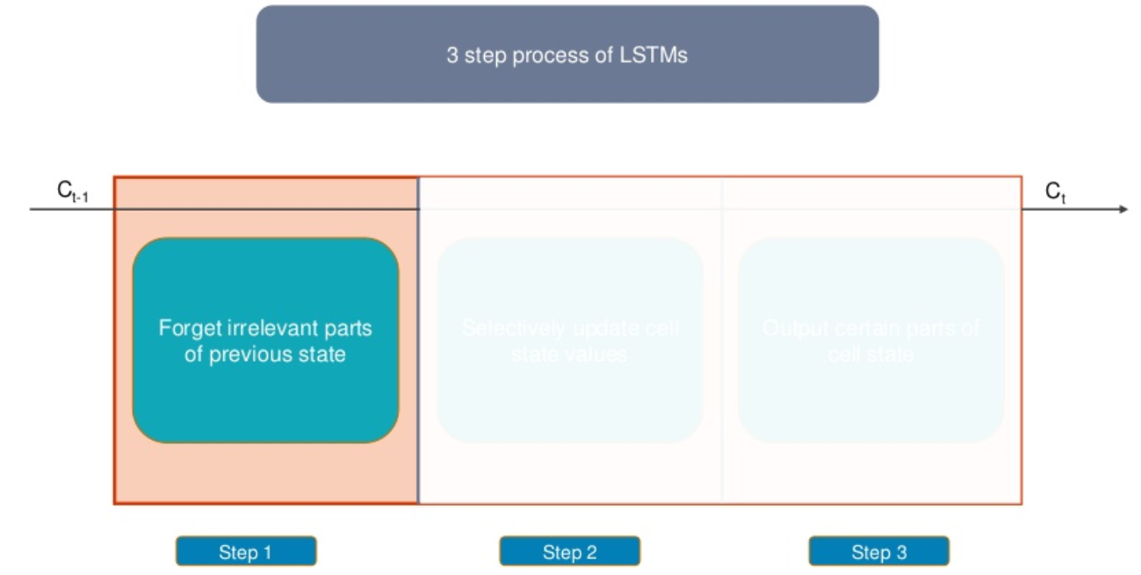
Long short term memory networks

Slide 29
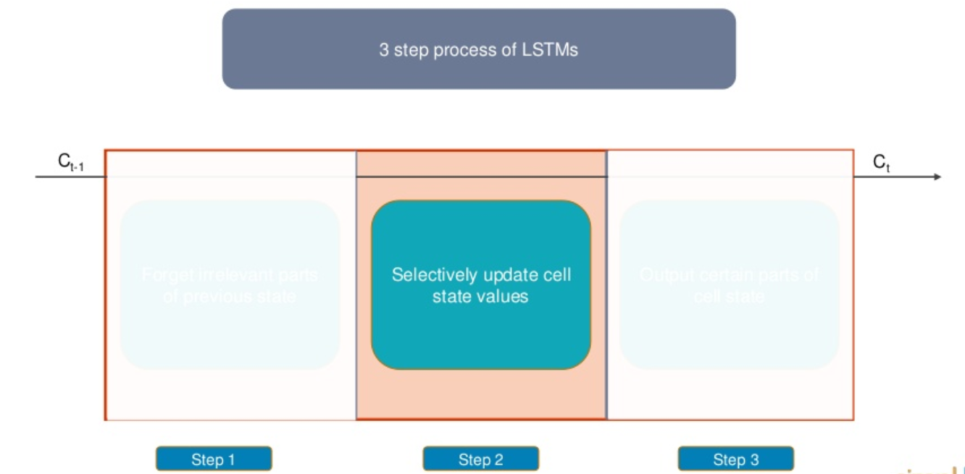
Long short term memory networks

Slide 30
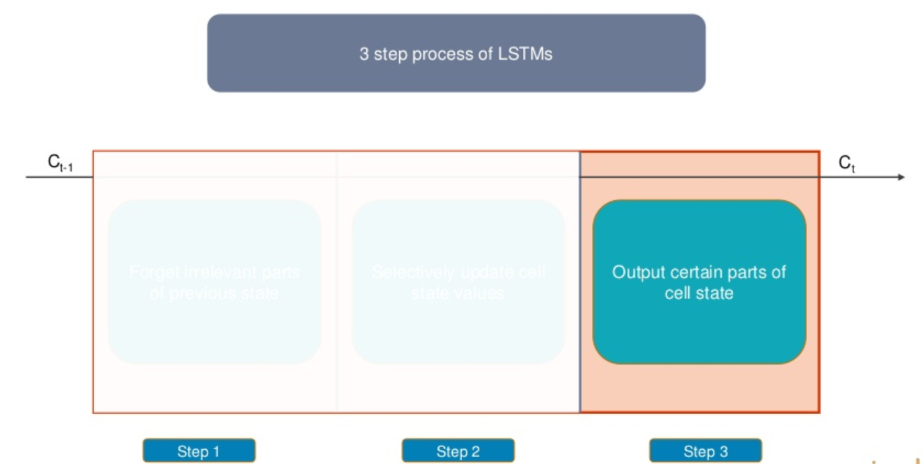
Long short term memory networks

Slide 31
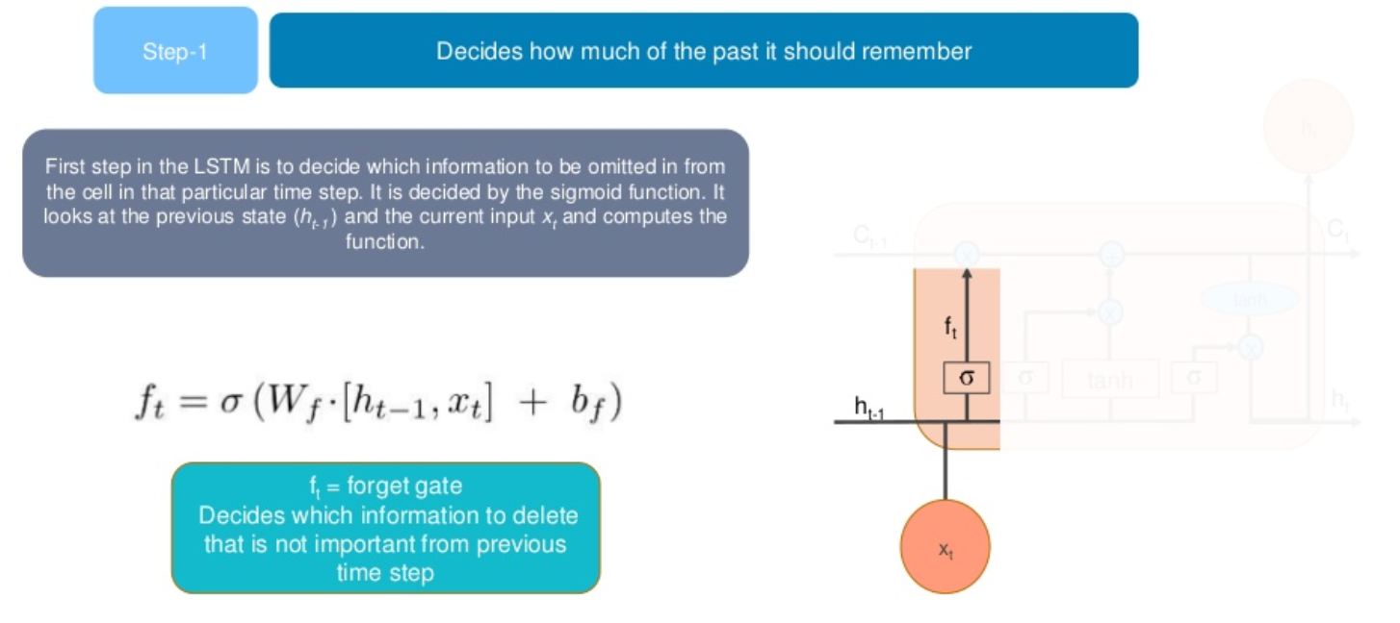
Working with LSTM’s

Slide 32
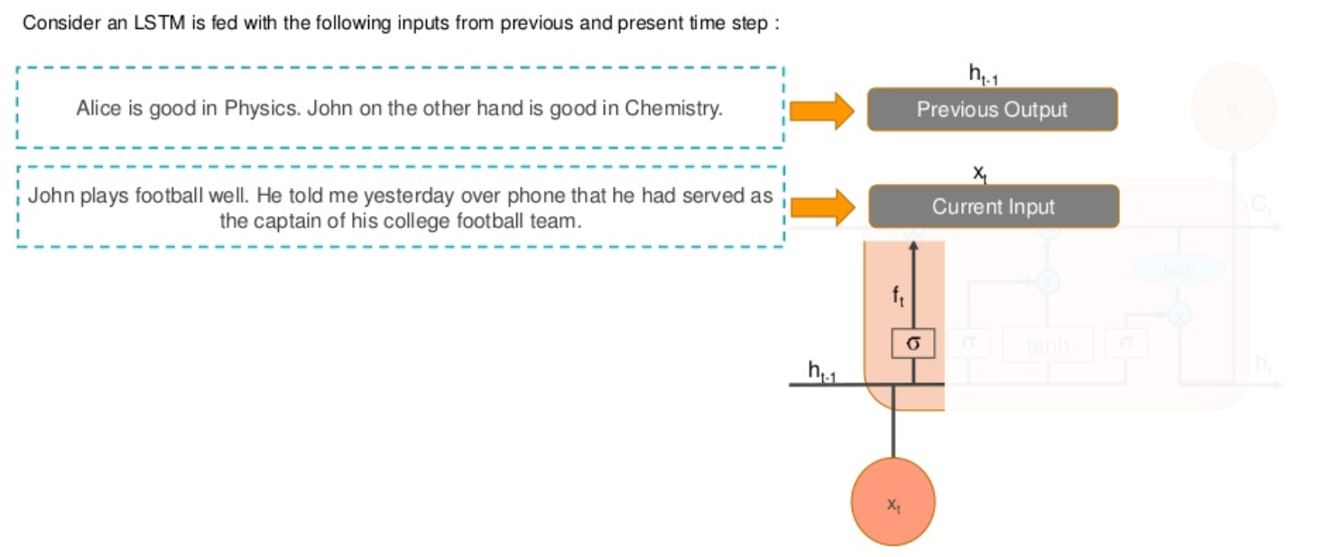
Working with LSTM’s

Slide 33
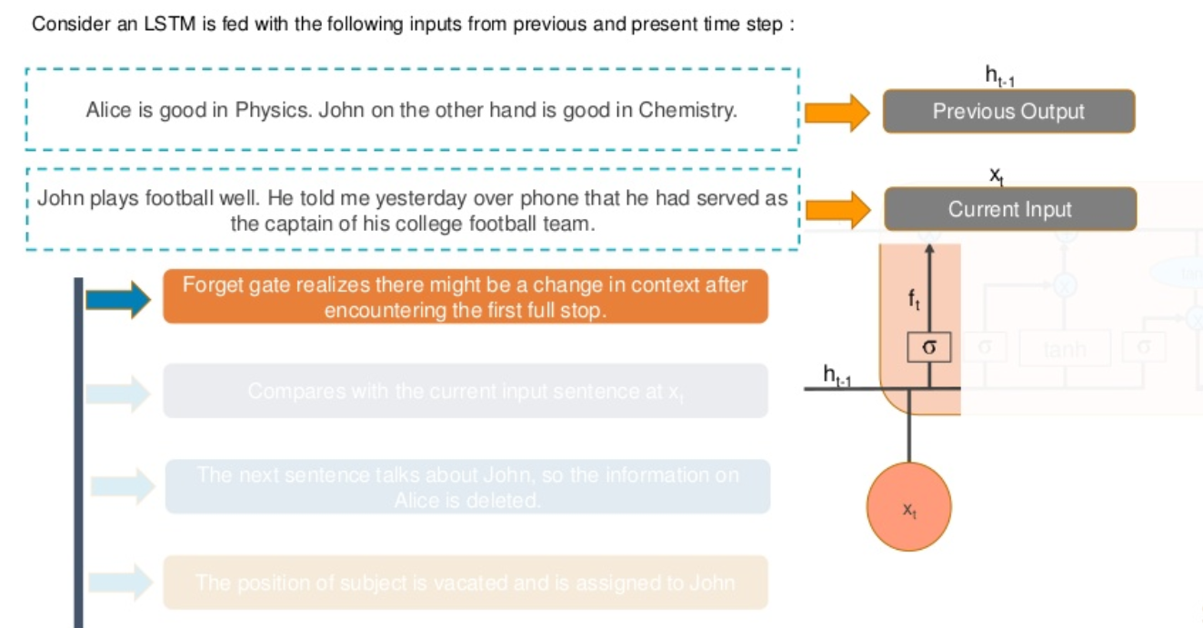
Working with LSTM’s

Slide 34
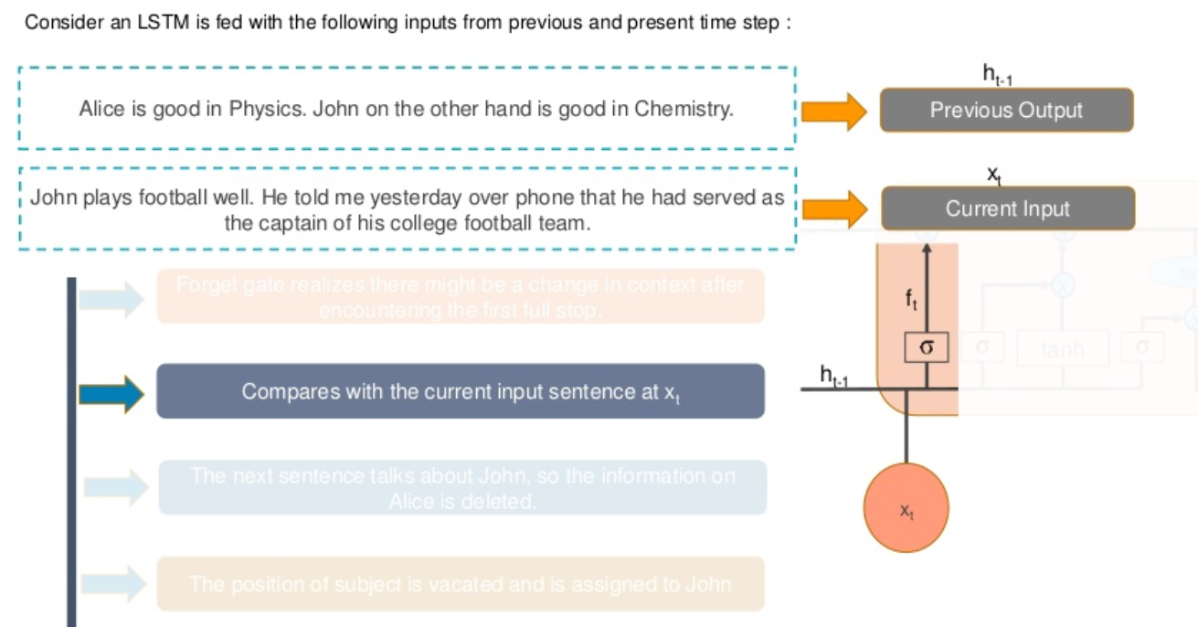
Working with LSTM’s

Slide 35
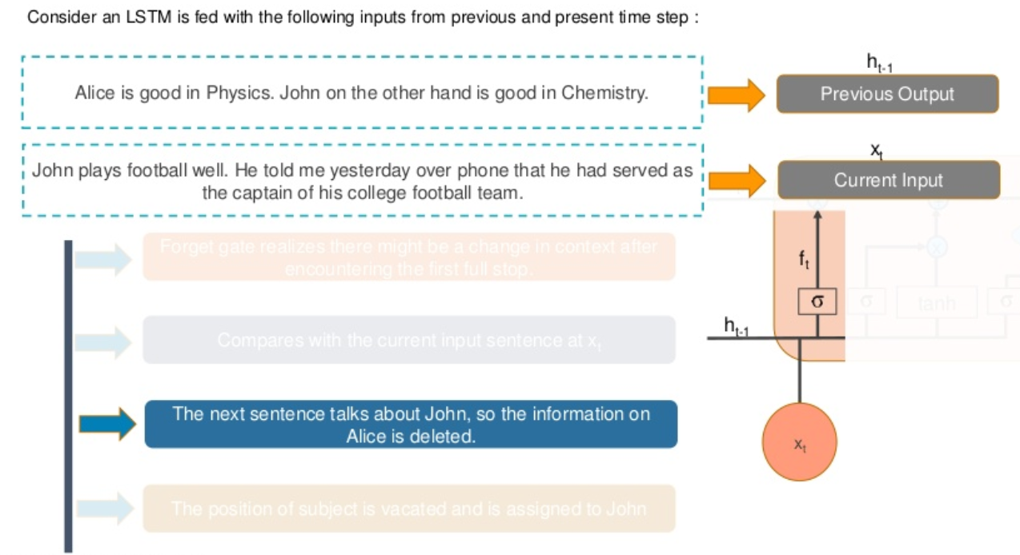
Working with LSTM’s

Slide 36
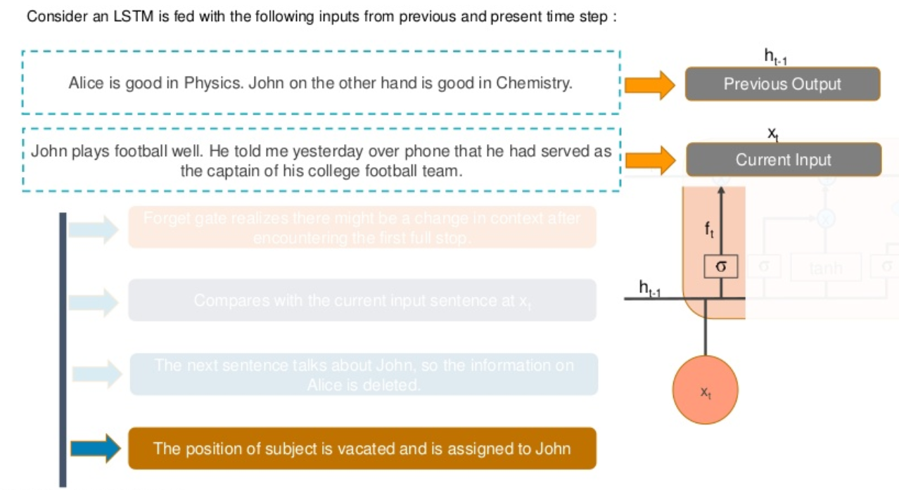
Working with LSTM’s

Slide 37
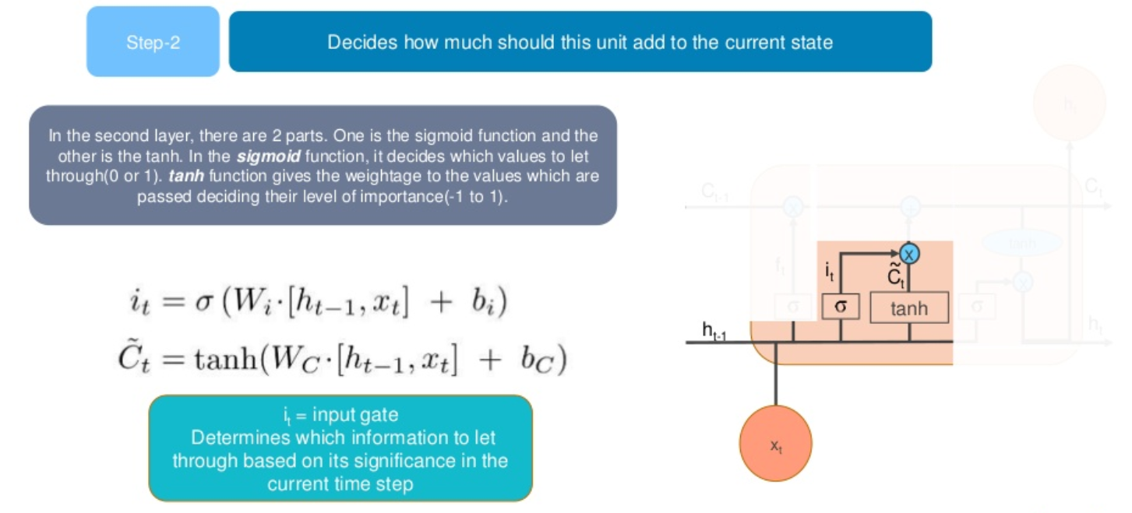
Working with LSTM’s

Slide 38
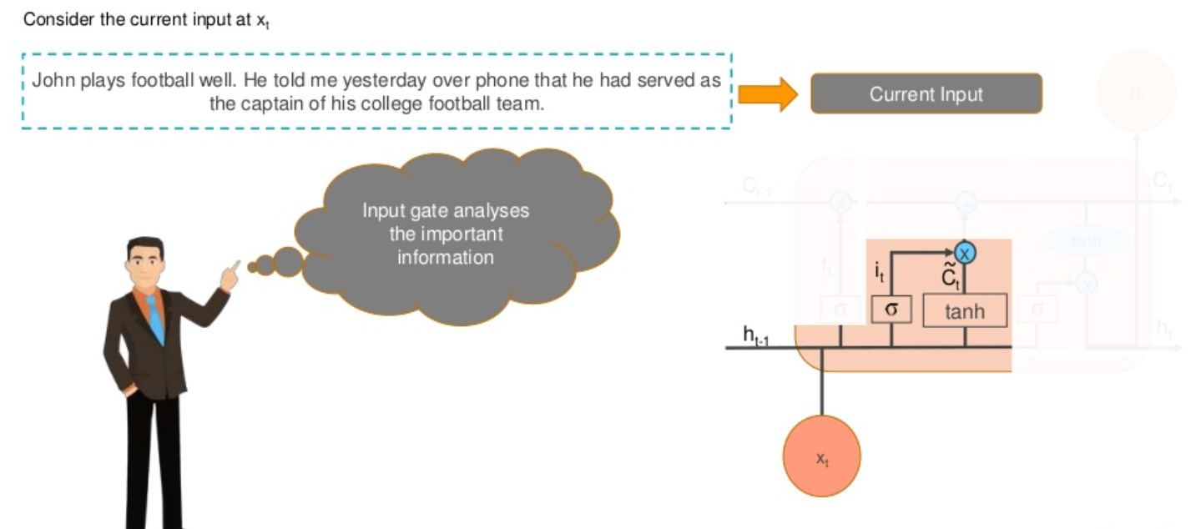
Working with LSTM’s

Slide 39
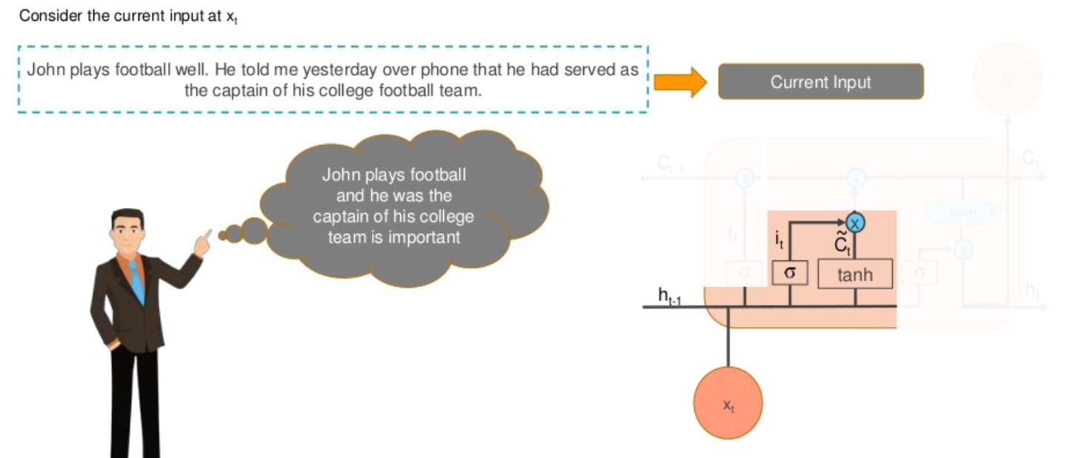
Working with LSTM’s

Slide 40
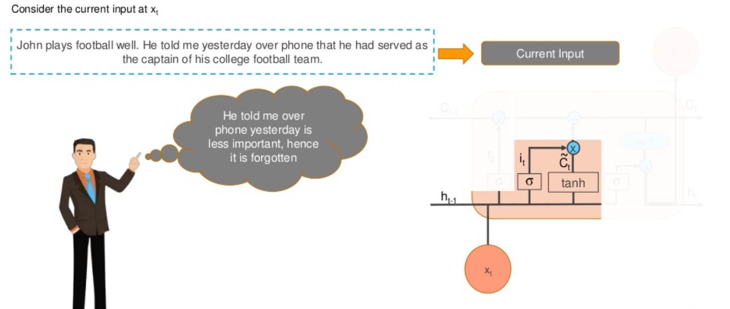
Working with LSTM’s

Slide 41
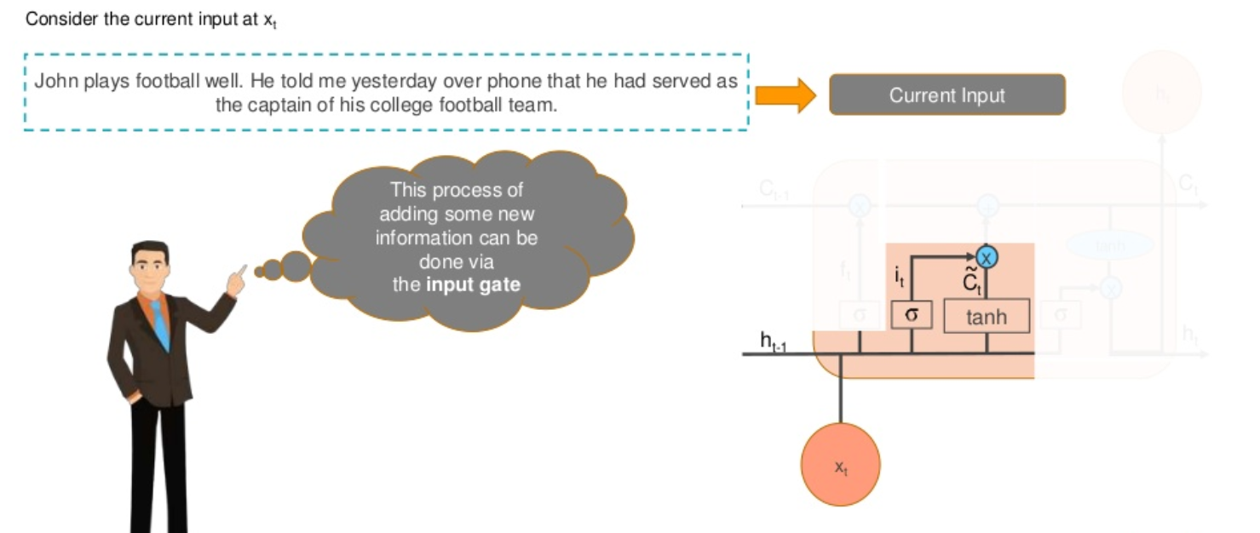
Working with LSTM’s

Slide 42
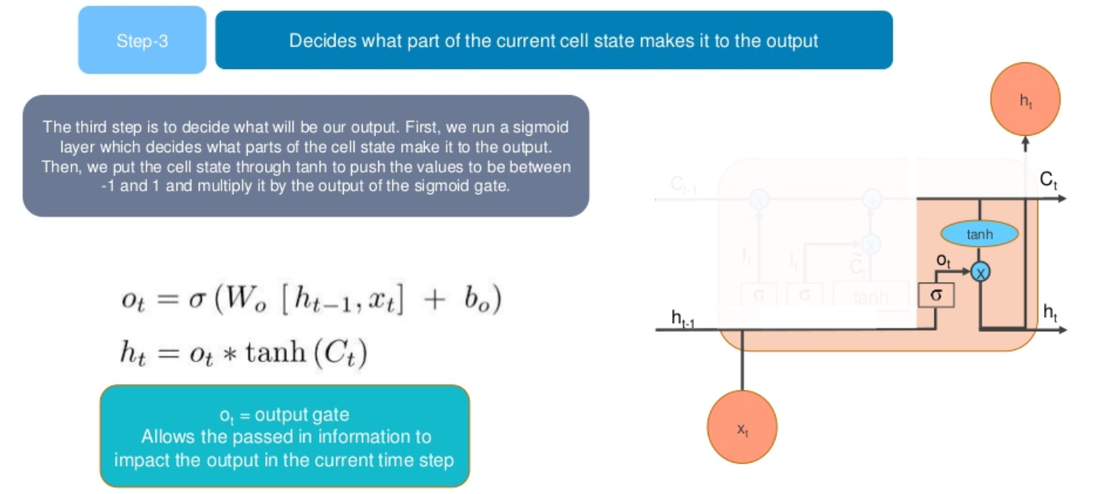
Working with LSTM’s

Slide 43
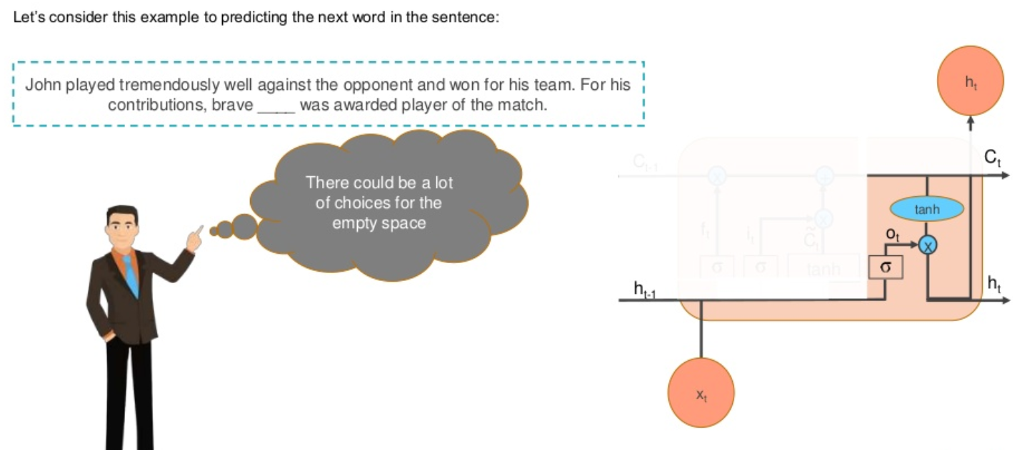
Working with LSTM’s

Slide 44
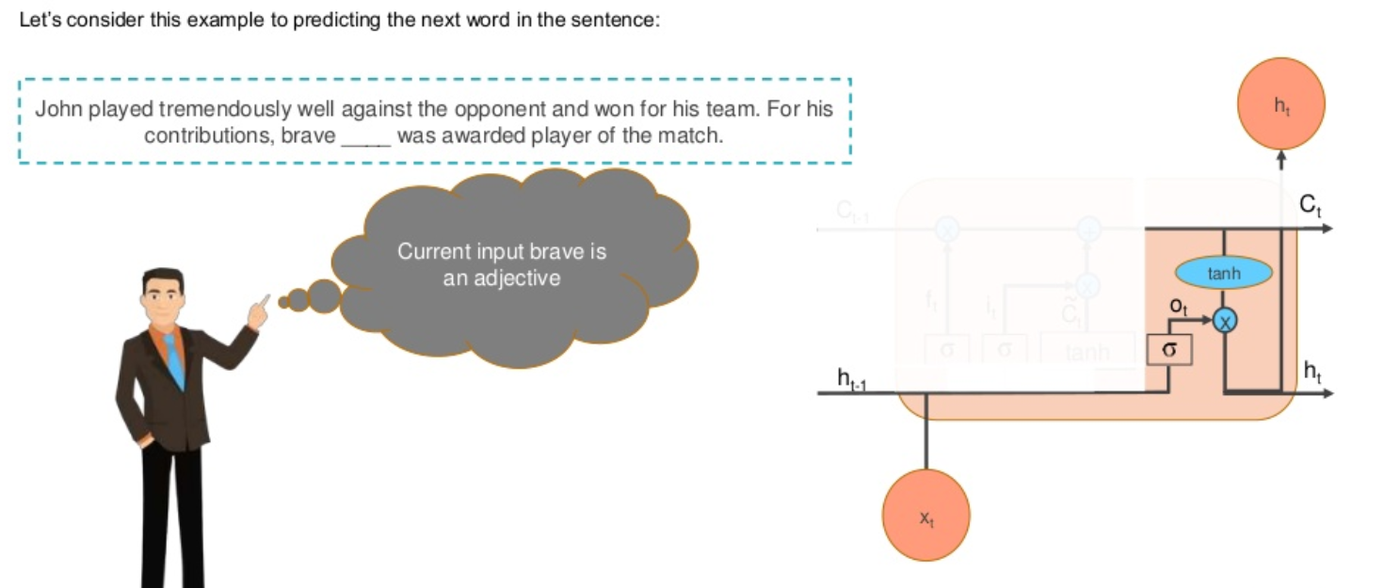
Working with LSTM’s

Slide 45
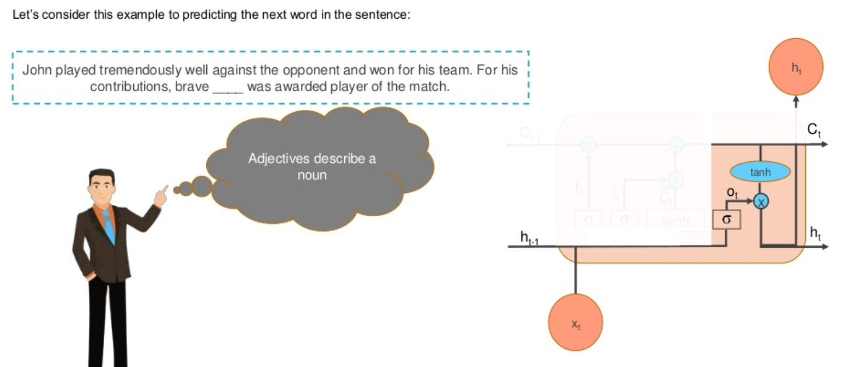
Working with LSTM’s

Slide 46
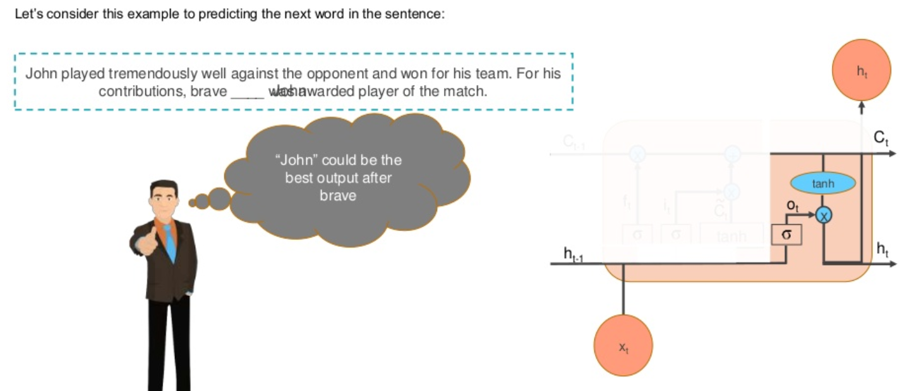
Working with LSTM’s

Slide 47

Working with LSTM’s

